Slide 1





LD Score – new methods for heritability
Found on IBG website
Benjamin Neale, Ph.D.
Analytic and Translational Genetics Unit, MGH
Stanley Center for Psychiatric Research & Program in Medical and Population Genetics, Broad Institute

Slide 2
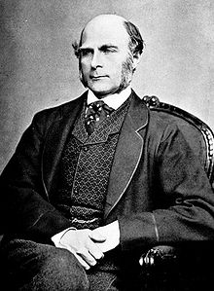
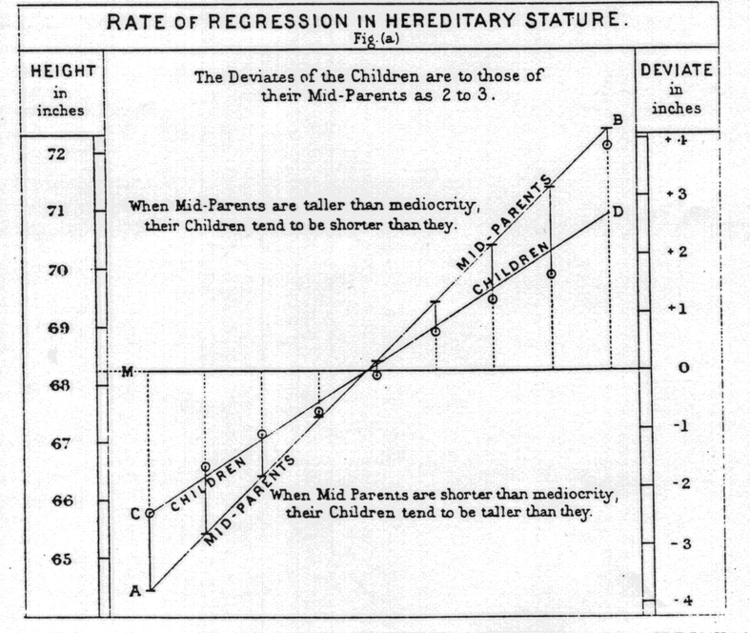
Galton
Children resemble parents
Origin of term “regression”

Slide 3
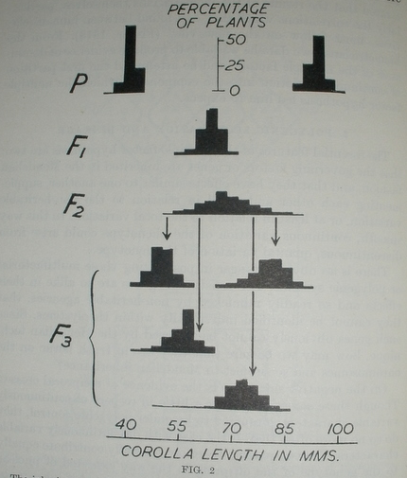
East 1915: Inheritance of corolla lemgth in Nicotiana Longiflora
Breeding experiments in plants clearly demonstrate polygenic inheritance

Slide 4
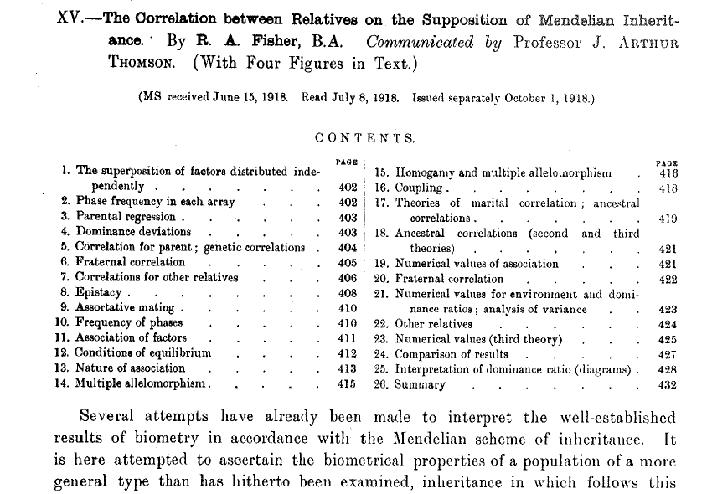
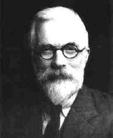
Neo-Darwinist reconciliation RA Fisher

Slide 5

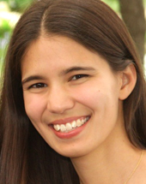
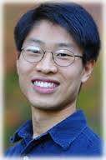


LD Score regression
With thanks
Brendan Bulik-Sullivan
Hilary Finucane
Po-Ru Loh
Mark Daly
Alkes Price

Slide 6
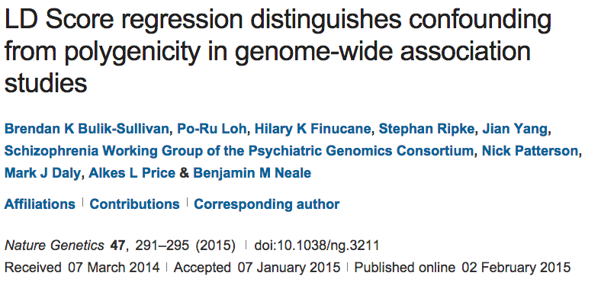
How does LD shape association?

Slide 7
How does LD shape association?
Lonely SNPs [no LD]
LD blocks

Slide 8
How does LD shape association?
Lonely SNPs [no LD]
LD blocks
*
Causal variants
*
Association
All markers correlated with a causal variant show association

Slide 9
How does LD shape association?
Lonely SNPs [no LD]
LD blocks
*
Causal variants
*
Association
Lonely SNPs only show association if they are causal

Slide 10
What happens under polygenicity?
Lonely SNPs [no LD]
LD blocks
*
Causal variants
Assuming a uniform prior, we see SNPs with more LD friends showing more association
The more you tag, the more likely you are to tag a causal variant

Slide 11
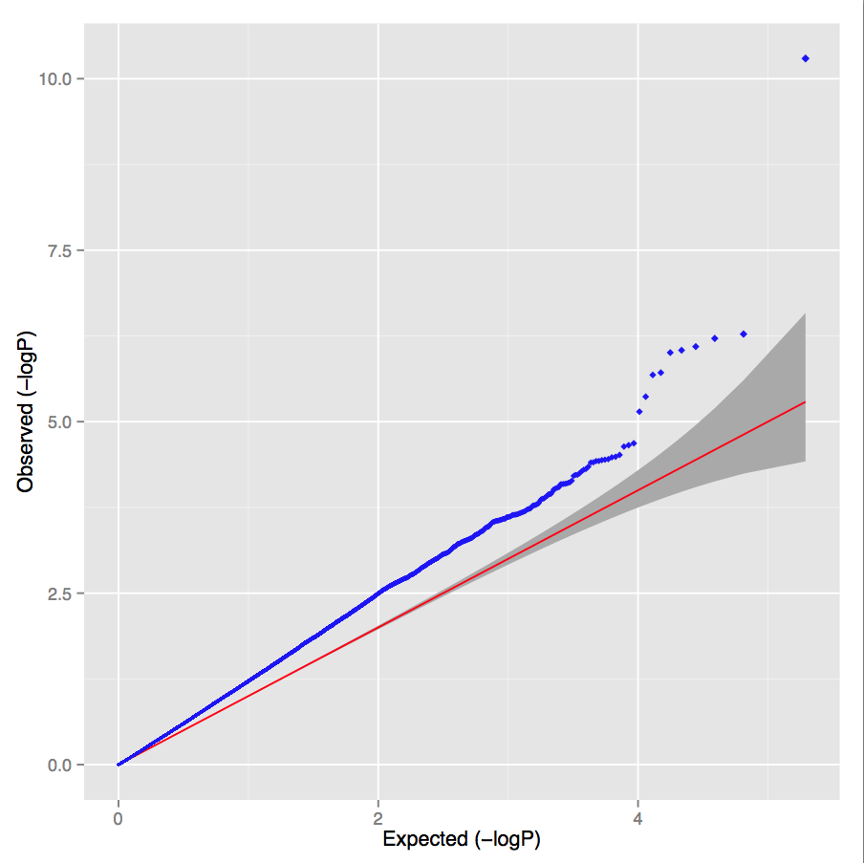
Simulated polygenic architecture Lambda = 1.30 LD score intercept = 1.02

Slide 12
What happens under stratification?
Lonely SNPs [no LD]
LD blocks
*
Causal variants
Under pure drift we expect LD to have no relationship to differences in allele frequencies between populations

Slide 13
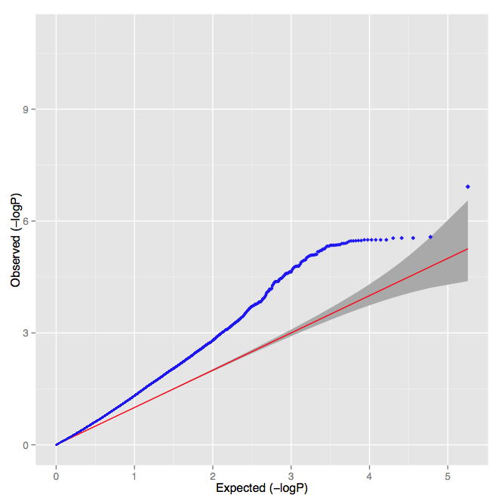
UK controls versus Sweden controls Lambda = 1.30 LD score intercept = 1.32

Slide 14
PGC Schizophrenia
Lambda = 1.48
Intercept = 1.06
Slope p-value < 10⁻³⁰⁰
Overwhelming majority of inflation is consistent with polygenic architecture

Slide 15
LD Score regression
Draw polygenic effects from
N (0, h²/m), var =
β
What is the E[χ²] for variant j?
New estimator of heritability
where N=sample size, M=# of SNPs, a=inflation due to confounding,
h²g is heritability (total obs.) and l_{j} is the LD Score
Bulik-Sullivan et al. Nature Genetics 2015
Yang et al. EJHG 2011

Slide 16
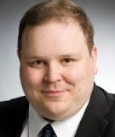

Brainstorm Project
Verneri Anttila
Aiden Corvin
Brendan Bulik-Sullivan
Hilary Finucane
Jonathan Rosand
Aarno Palotie
Mark Daly
Patrick Sullivan
Bobby Koeleman
Nick Wood
Julie Williams
Alessandro Biffi
Jeremiah Scharf
Kenneth Kendler
Stephan Ripke
Alkes Price
Chris Cotsapas
Padhraig Gormley
Zhi Wei
Rainer Malik
Hailiang Huang
Andrea Byrnes
Dongmei Yu
Laramie Duncan
Kai-How Farh
Namrata Gupta
Miriam Raffeld
…and many, many others
in their respective study groups

Slide 17
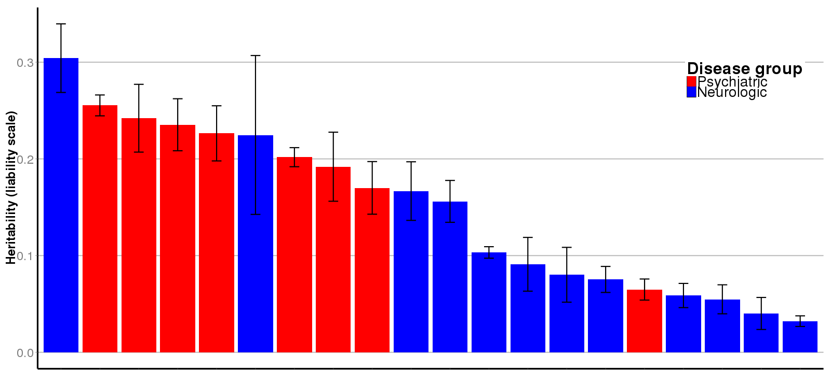
Univariate heritability from common variation
GGE = Generalized Epilepsy
SCZ = Schizophrenia
OCD = Obsessive Compulsive Disorder
AUT = Autism
TSY = Tourette’s Syndrome
ICH = Intracerebral Hemorrhage
BPD = Bipolar Disorder
MDD = Major Depressive Disorder
ANO = Anorexia Nervosa
MSC = Multiple Sclerosis
MWO = Migraine without Aura
MIG = Migraine
MWA = Migraine with Aura
EOS = Early Onset Stroke
AZD = Alzheimer’s Disease
ADD = Attention Deficit/Hyperactivity
EPI = Epilepsy (all)
ISS = Ischemic Stroke
NFE = Non-acquired focal epilepsy
PKD = Parkinson’s Disease
GGE
SCZ
OCD
AUT
TSY
ICH
BPD
MDD
ANO
MSC
MWO
MIG
MWA
EOS
AZD
ADD
EPI
ISS
NFE
PKD
It’s all heritable!

Slide 18
Key extension 1 Functional partitioning
Lonely SNPs [no LD]
DHS
LD blocks
Coding
*
Causal variants
LD Score 9 1 4 1 5
Finucane et al. 2015 Nat Gen

Slide 19
Key extension 1 Functional partitioning
Lonely SNPs [no LD]
DHS
LD blocks
Coding
*
Causal variants
LD Score 9 1 4 1 5
DHS Score 5 0 0 0 0
Coding Score 0 0 1 1 3
Finucane et al. 2015 Nat Gen

Slide 20
Annotations

Slide 21
Datasets for GWAS Selected for a Z>7 for h²
Phenotype | Reference |  | Phenotype | Reference
Height | Lango Allen, 2010 |  | Schizophrenia | PGC, 2014
BMI | Speliotes, 2010 |  | Bipolar | Sklar, 2011
Age of menarche | Perry, 2014 |  | Anorexia | Boraska, 2014
LDL | Teslovich, 2010 |  | Education years | Rietveld, 2013
HDL | Teslovich, 2010 |  | Ever smoked | TAG, 2010
Triglycerides | Teslovich, 2010 |  | Rheumatoid Arth | Okada, 2014
CAD | Schunkert, 2011 |  | Crohn’s Disease | Jostins, 2012
T2D | Morris, 2012 |  | Ulcerative Colitis | Jostins, 2012
Fasting Glucose | Manning, 2012

Slide 22
Average enrichments per class Collapsed results across 17 traits
Category | % SNPs | % h² | Enrichment
Conserved | 2.6 | 34.7 | 13.4x
Coding | 1.5 | 10.4 | 7.0x
H3K4me3 | 13.3 | 34.4 | 2.6x
H3K4me3 (peaks) | 4.2 | 15.8 | 3.8x

Slide 23
LD Score regression Genetic correlation
Trait 1
Slope estimates heritability

Slide 24
LD Score regression Genetic correlation
Trait 1
We can a second trait and obtain two heritability estimates
Trait 2

Slide 25
LD Score regression Genetic correlation
Trait 1
Z*Z = χ²
So we can estimate genetic covariance from the product of the Z-scores
Trait 2

Slide 26
LD Score regression Genetic correlation
Trait 1
Z*Z = χ²
So we can estimate genetic covariance from the product of the Z-scores for the two traits
R_{G} = 0.5
Trait 2
R_{G}

Slide 27
LD Score regression Genetic correlation
Trait 1
Here R_{G} = 0
This approach is robust to sample overlap as all variants are equally inflated
Trait 2
R_{G}

Slide 28
Within psychiatry
Broad sharing of common genetic risk factors across psychiatric illness
Risk factors do not respect traditional boundaries
* denotes significant correlation

Slide 29
Conclusions
Direct estimation of heritability from GWAS is possible
Heritability is an arbiter of relative importance for classes of variation
Heritability can be used to elucidate the relationships between different phenotypes

